Slide 1
Week2 meeting

Slide 2
Datasets registration
database | Registration state
Himawari-8,9 (Ptree) | Finished but without view by ftp
ERA5, CMIP6 | Finished and tried visualization
ISCCP | Still waiting for the applying
powerInfoV2 | Logged by day, not easy to fetch
ESCOMP/CESM | A complicate model for simulation on git
發電裝置容量 民國99年01月～114年04月 | simple but clear
TCCIP

Slide 3
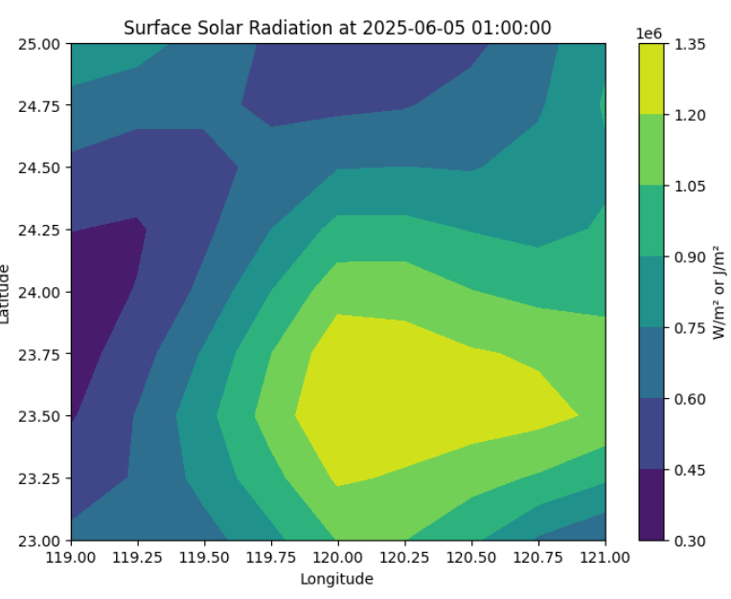
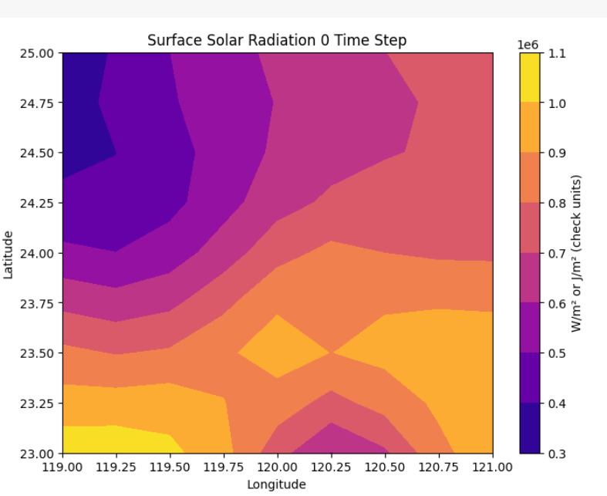
Visualization (era5)

Slide 4
Taiwan pv current situation(lit review)
Prospects of Taiwan's solar energy development and policy formulation:
Mainly study the module and policy in Taiwan, formulate by the panel angle, data base on cwt gov
Understanding Barriers to Solar Energy Use in Taiwan Using the Decision Making Trial and Evaluation Laboratory Integrated with the Technique for Order Preference by Similarity to an Ideal Solution
Top 5 Most Critical Barriers (in order of priority by TOPSIS):
Geographical and topographical constraints – Limited flat land, especially in densely populated or mountainous areas.
Insufficient rooftop space – High-rise urban buildings limit large-scale rooftop installations.
Inadequate solar radiation in some regions.
Lack of effective government incentives and long-term support mechanisms.
Environmental concerns about land use, biodiversity, and ecosystem impact.

Slide 5
Taiwan pv current situation(lit review)
Using satellite images to investigate the solar panel installation and spatial injustice in Taiwan

Slide 6
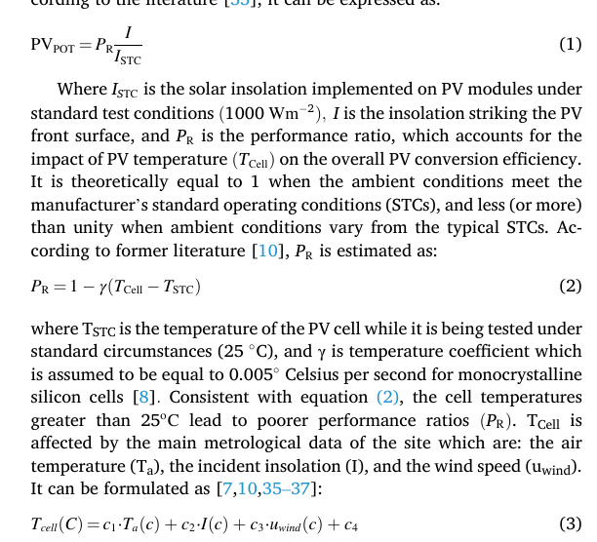
Paper review: Key Paper
資料來源: CCSM ArcGIS 格式的 shapefile(cesm model appliable, ccsm4 required license)
CMIP5 地理資訊系統的 18 個區域，在 RCP4.5 與 RCP8.5 情境下進行分析，預測四個時段（2020–2040、2041–2060、2061–2080、2081–2100）中的年均地表溫度、天空日照與光伏潛力變化
透過現有氣溫資料，以溫度變化差做為比對

Slide 7
Paper review of temperature and pv Effect of Temperature on PV Potential in the World
Huld T; Gottschalg R; Beyer H. G; Topic M. Mapping the performance of PV modules, effects of module type and data averaging, Solar Energy he is very good at this kind of plotting
在環境溫度為 40°C 時，傳統 c-Si 模組的發電效率損失接近 13%。此損失可透過使用溫度係數 αₚₘₐₓ < 0.0041°C⁻¹ 的 PV 模組減少，例如非晶矽（a-Si）或 CdTe 模組。這將提高高溫地區（如非洲、中東、澳洲）之 PV 潛力。相反地，在月均溫 < 6.6°C 的地區（如南極、喜馬拉雅與南安地斯）中，若 αₚₘₐₓ 較高，將導致性能下降，因為公式中的 𝑇𝐴𝑚+Δ𝑇−25T Am​ +ΔT−25 為負值（ΔT = 18.4°C）。
存在 JIS 與 PVGIS 結果差異大。這些城市地形多變（山脈、海洋、沙漠），導致天氣資料變化劇烈，使用低解析度天氣資料無法充分捕捉其特性。
https://www.data.jma.go.jp/stats/data/en/smp/index.html

Slide 8
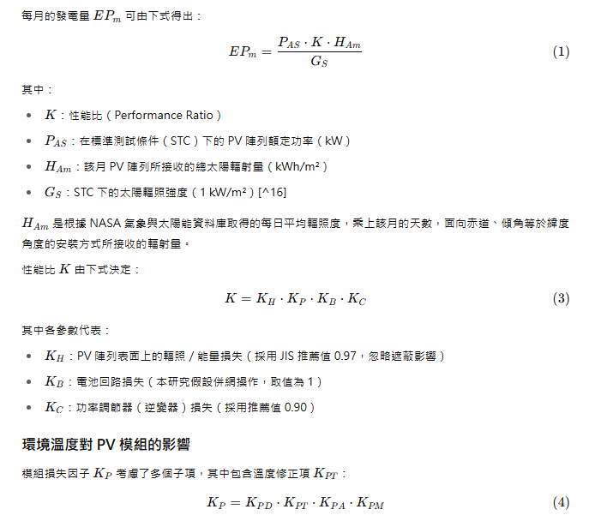
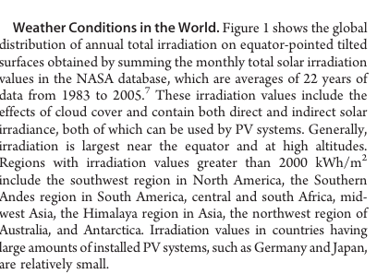

Slide 9
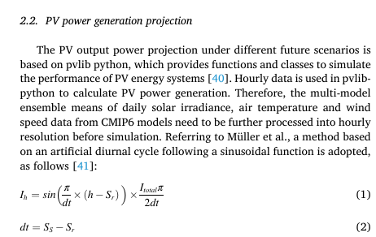
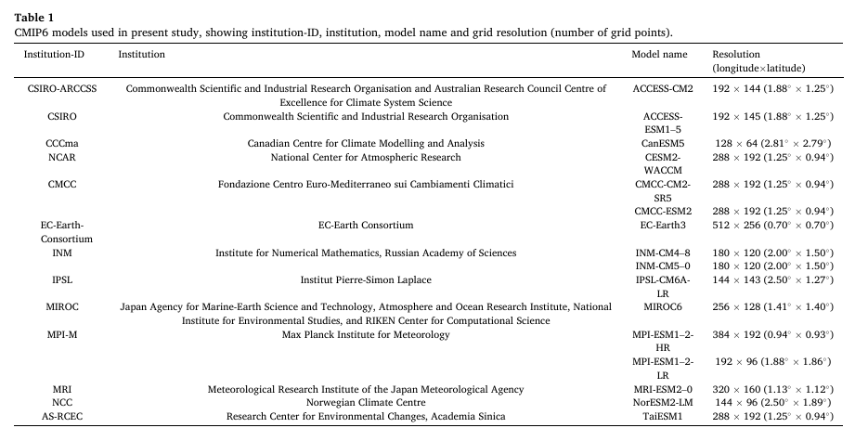

Paper review of era5 and cmip Different photovoltaic power potential variations in East and West China

Slide 10
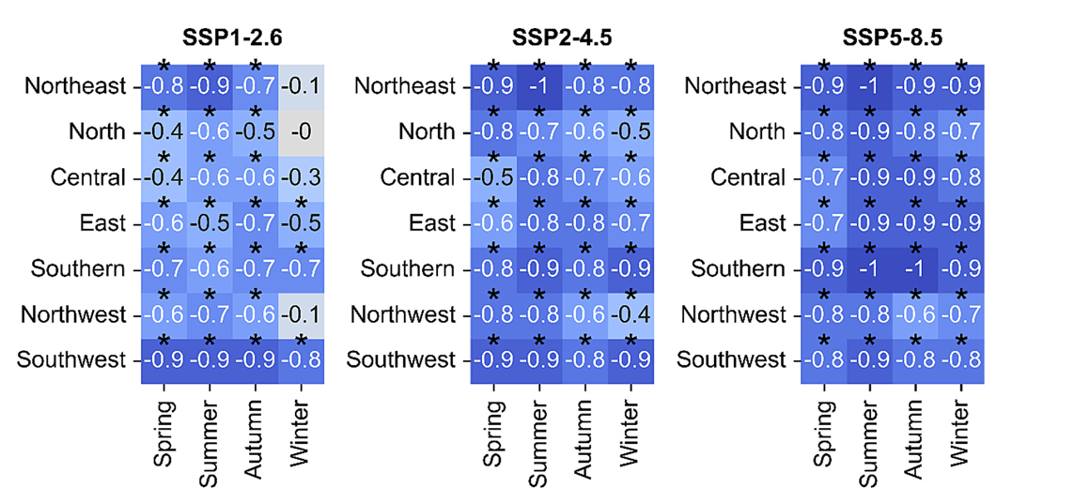
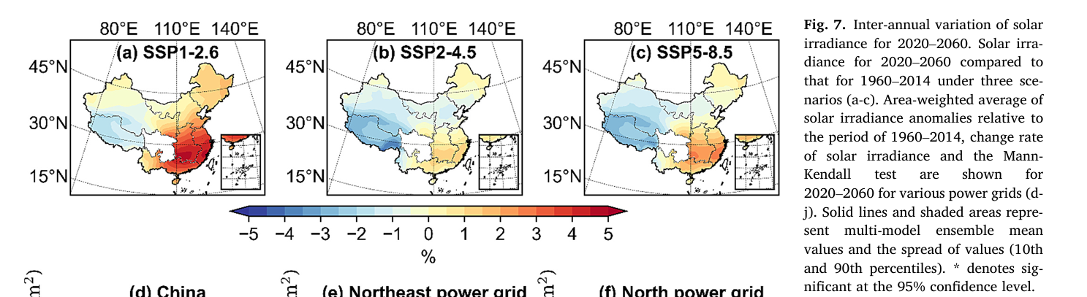
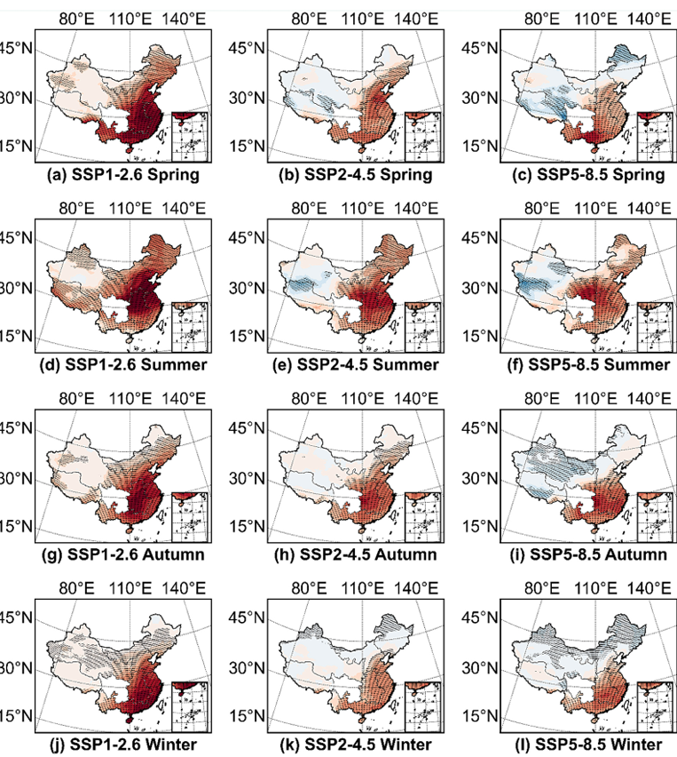
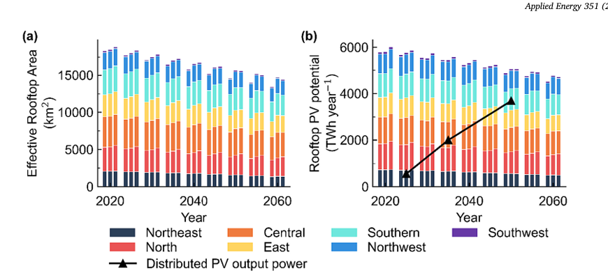
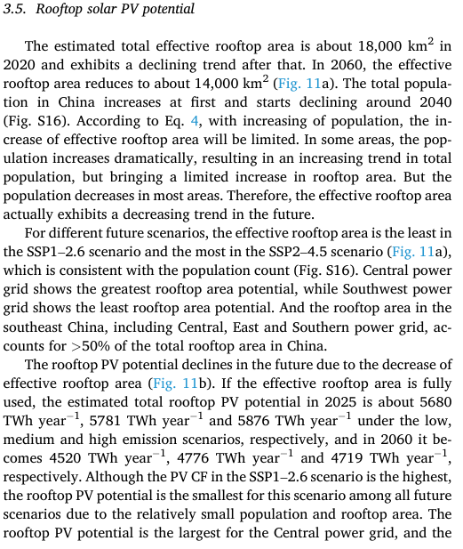
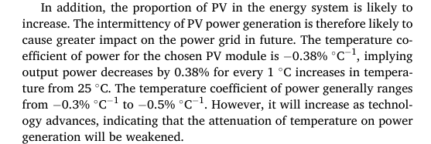
M-k test, directly get radiance- cloud/humidity relationship
Code - Different photovoltaic power potential variations in east and west China
comparing the solar irradiance for 2020–2060 with 1960–2014, east
and west China exhibit opposite results (Fig. 7). It is found that the solar
irradiance for 2020–2060 is higher in east China compared to that for
1960–2014, especially under the SSP1–2.6 scenario, by almost 5%,
while the solar irradiance for 2020–2060 in west China is lower than
that for 1960–2014, with the effect more pronounced under the
SSP2–4.5 and SSP5–8.5 scenarios. Except for Northwest and Southwest
power grids under the SSP2–4.5 and SSP5–8.5 scenarios, all power grids
exhibit an uptrend in three future scenarios, with the Central, East and
Southern power grids being the strongest and the Northwest and
Southwest power grid the weakest.

Slide 11
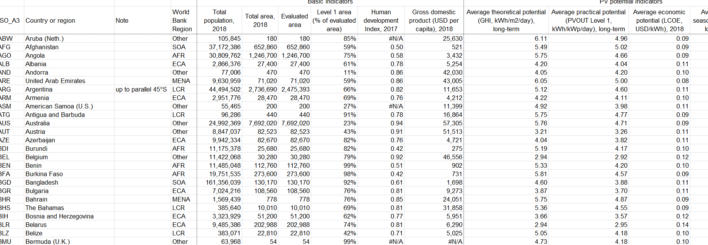
Exploration of global solar atlas
But Taiwan isn’t in the “ country” category

Slide 12
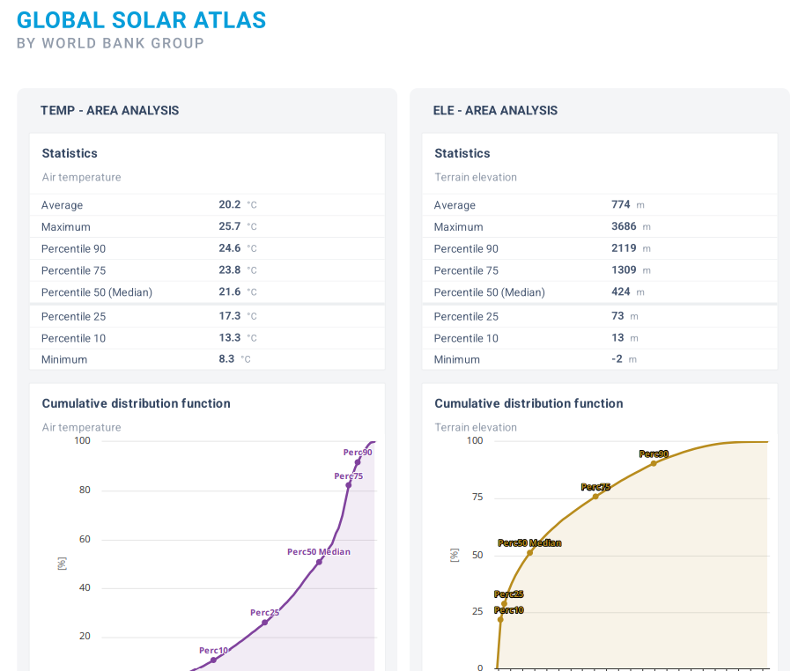
Solar data for Taiwan on global solar atlas
The dataset is based on the solargis, a charged data set which mentioned in week1, so the full functional data set should may not be found here

Slide 13
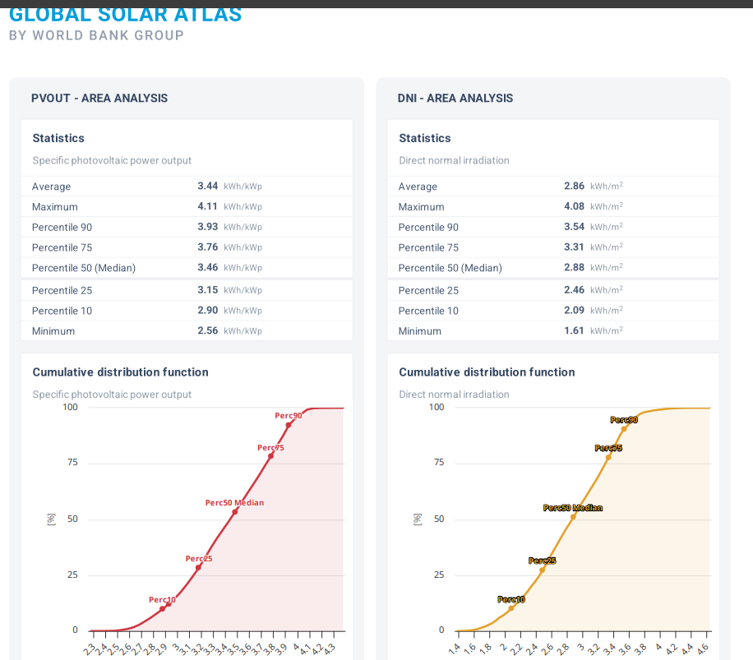
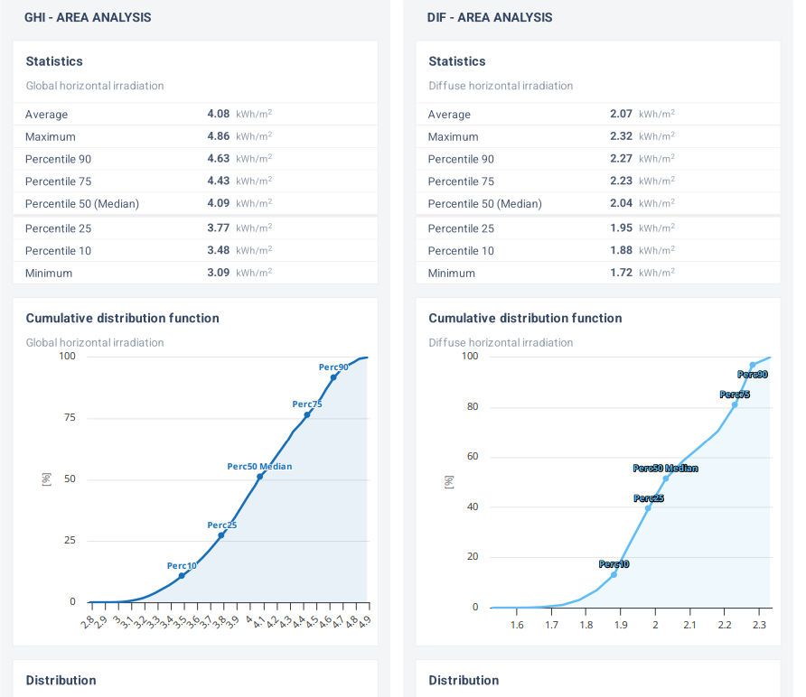

Slide 14
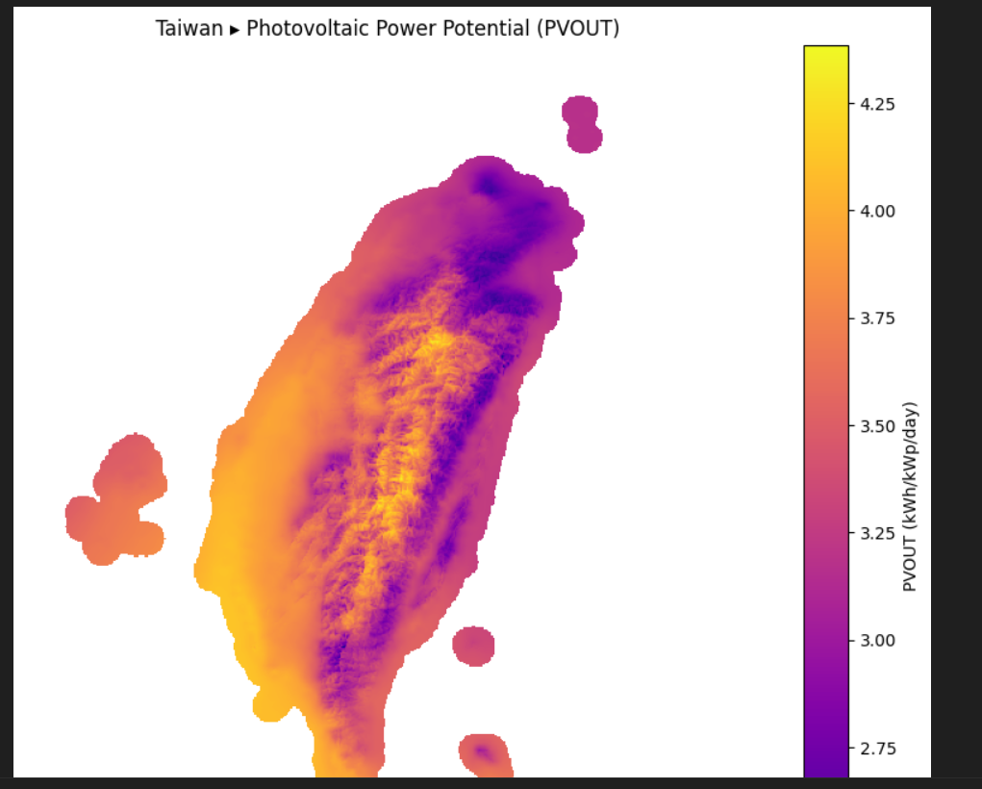
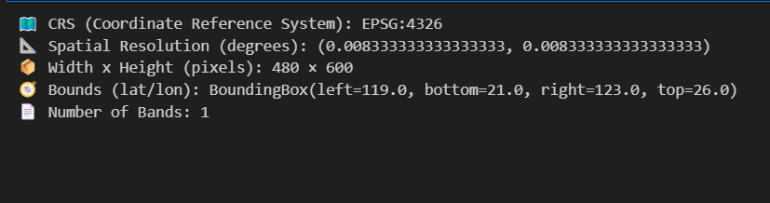
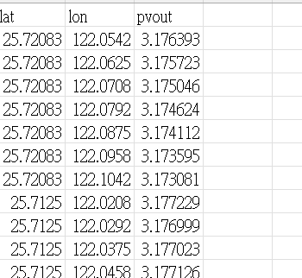
The tif from the download section is visualizeable and the csv is set

Slide 15
Data on collecting (CMIP6)
Model :MIROC6 (Japan) or CESM2 (USA) or BCC-CSM2-MR (China)
Experiment ssp4.5 and ssp8.5 are the common pairs
✅ Air temperature / Near-surface air temperature: Used to compute PV cell temperature and temperature-dependent efficiency loss
✅ Surface downwelling shortwave radiation: Proxy for solar insolation reaching the surface — key for PV output
✅ Surface temperature: Alternative to near-surface air temp; useful for land-surface interaction modelling
✅ Near-surface wind speed: as a pv placement condition

Slide 16
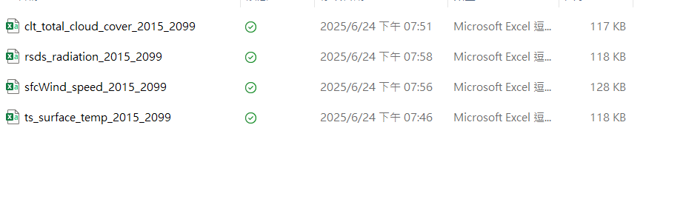
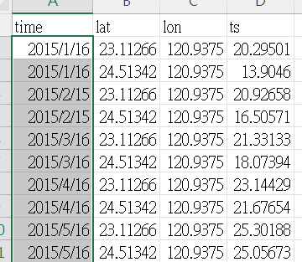
The data is set, but there’s only 2 grid point ☹
CMIP5/6 (global) data is likely too coarse for accurate local analysis without downscaling.
CORDEX-East Asia (regional model): ~25 km resolution
NEX-GDDP-CMIP6: ~25 km globally (recommend by chat)

Slide 17
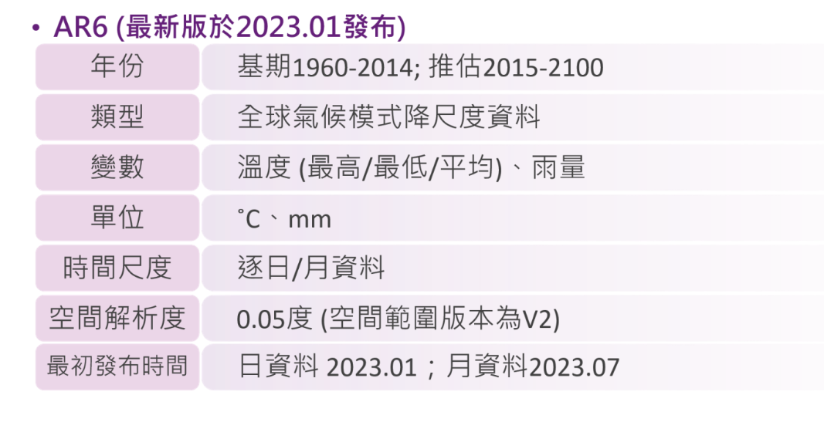
alternatives
CORDEX-East Asia working on this now
NEX-GDDP-CMIP6
ISCCP(also monthly)
iccp/ar6
TCCIP/TaiESM
Notes:
1. IPCC WGI Data Distribution Centre (DDC)
What it is: Official data provider for IPCC Working Group I.
What it offers: Processed output from CMIP5 and CMIP6, covering surface temperature rise, precipitation, extreme events, and emissions scenarios (RCPs and SSPs).
Use case: Access regional projections for warming levels (e.g., +1.5 °C, +2 °C, +4 °C).
Website: https://www.ipcc-data.org/
🔹 2. CMIP6 / CMIP5 via Earth System Grid Federation (ESGF)
What it is: Global hub of raw and processed data from multiple climate models.
Strength: Offers multi-model ensembles, future scenario data (SSP1–5), detailed variable coverage.
Variables: Surface temperature, max/min temp, radiative forcing, sea surface temp, ocean heat, etc.
Website: https://esgf-node.llnl.gov/search/cmip6/
🔧 Requires familiarity with NetCDF format and climate data tools like xarray, CDO, or Panoply.
🔹 3. NASA Earth Exchange (NEX-GDDP & NEX-GDDP-CMIP6)
What it is: Downscaled CMIP5 and CMIP6 datasets with high resolution (0.25°), global coverage.
Features:
Daily projections (1950–2100)
RCP4.5 & RCP8.5 / SSPs
Includes bias-corrected temperature and precipitation
Good for: Climate impact models, especially for energy and agriculture.
Access: https://www.nccs.nasa.gov/services/data-collections/land-based-products/nex-gddp

Slide 18
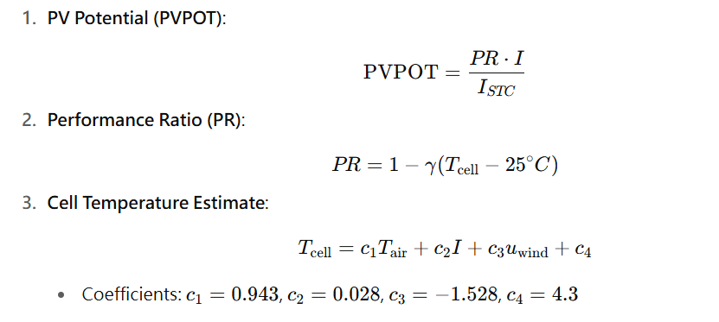
Data on collecting (PV)
The dependent relationship of pv modules and temperature(and other factor):
Key paper:

Slide 19
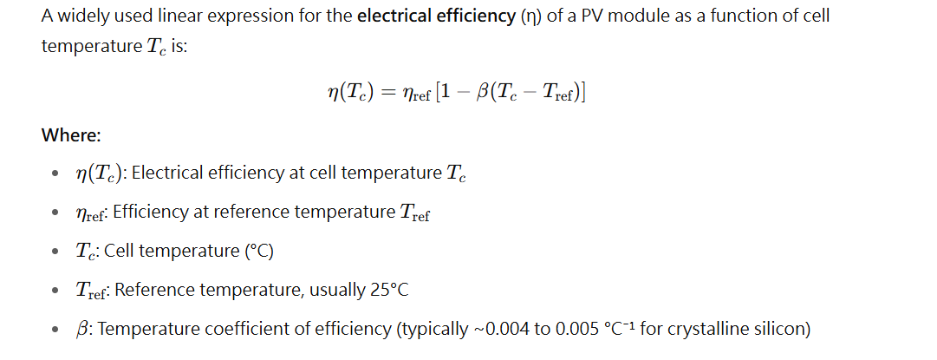
Data on collecting (PV)
The Impact of Global Warming on Silicon PV Energy Yield in 2100 :-0.45%/K ,0.3~0.6
Temperature Dependent Photovoltaic (PV) Efficiency and Its Effect on PV Production in the World A Review

Slide 20
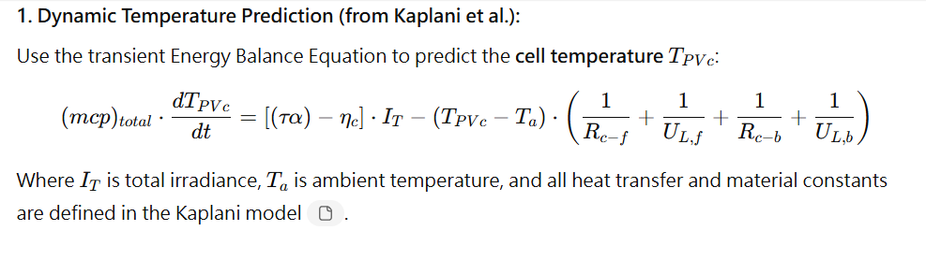
Data on collecting (PV)
Dynamic Electro-Thermal PV Temperature and Power Output Prediction Model for Any PV Geometries in Free-Standing and BIPV Systems Operating under AnyEnvironmental Conditions
PHOTOVOLTAIC MODULE THERMAL/WIND PERFORMANCE: Long -Term Monitoring and Model Development For Energy Rating

Slide 21
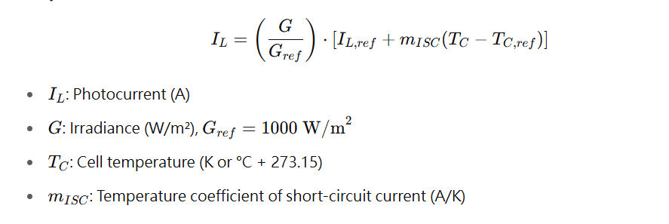
Data on collecting (PV)
A detailed modeling method for photovoltaic cells

Slide 22
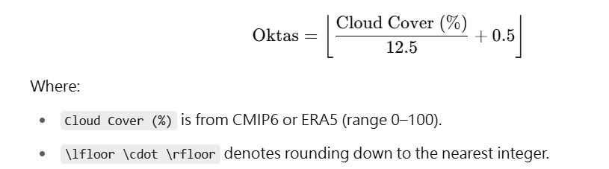
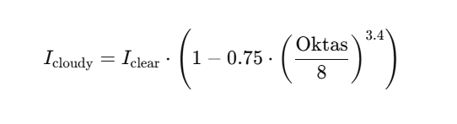
Method supplement : cloud cover portion
Find datasets of Oktas(but high chance not suitable)
Convert the total cloud cover into Oktas
Can further research the effect of cloud in different heights

Slide 23
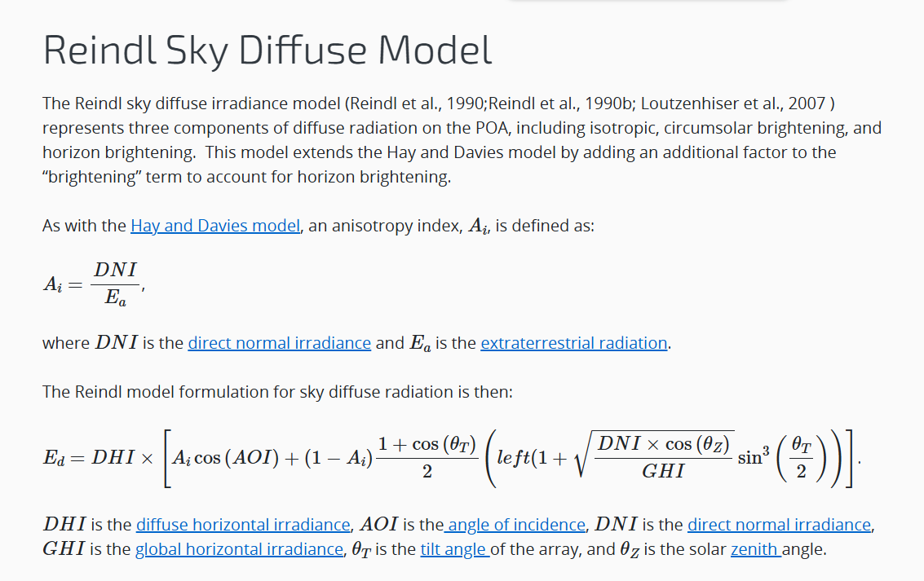
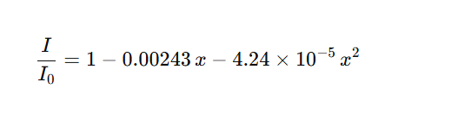


Slide 24
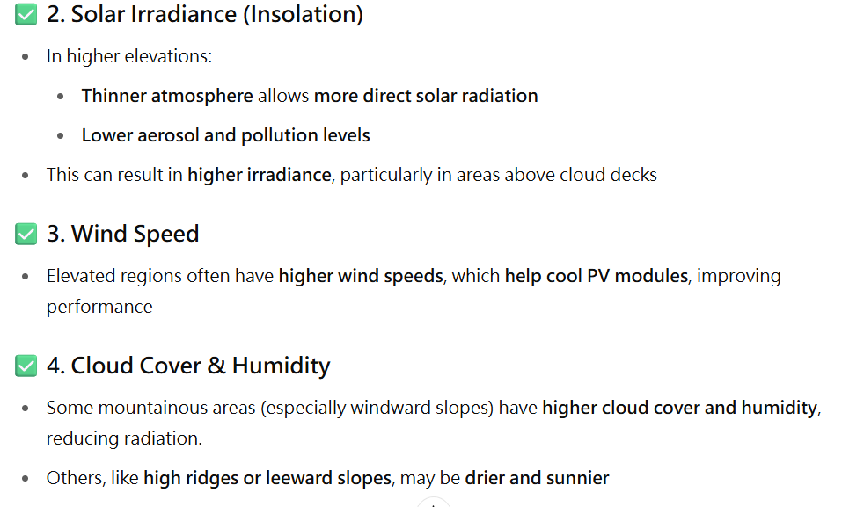
Method supplement : elevation

Slide 25
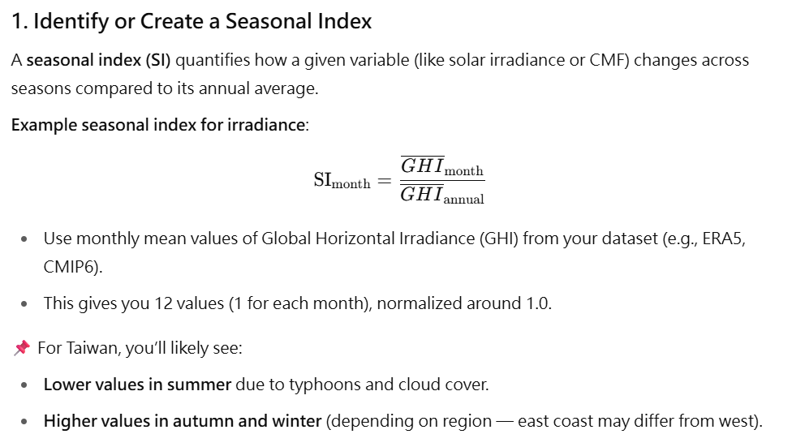
Method supplement :seasonal index
In many regions, total annual rainfall may not decrease drastically, but the number of rainy days decreases while individual rain events become more intense. This shift in rainfall distribution is called a “wet-get-wetter, dry-get-drier” pattern in many models.
BY applying the TMY database to get/train for the a seasonal/ annual normality

Slide 26
Method supplement : rainydays
A study found that low and moderate rainy days decline by ~24.7 ± 9.5% per °C of surface warming:
Quantifying the impact of global warming on precipitation patterns in India
Experiments (e.g., Sun et al. 2007) indicate that wet-day frequency decreases by about 2% per degree (K) of warming

